Slide 1

Grahame Grieve
Commonwell
18-Sept 2013

Slide 2

Healthcare Standards
Complex…. Slow…
Hard to use and understand
Require specialist skills, tools
Costly

Slide 3
Healthcare Standards
Complex…. Slow…
Hard to use and understand
Require specialist skills, tools
Costly
What if it didn’t have to be like that?

Slide 4
Introducing FHIR
Fast Health Interoperability Resources
Pronounced “Fire”
Based on industry best practices, with a focus on simplicity and implementability
…insert your fire related joke here….

Slide 5
Why FHIR?
Arose out of Fresh Look Taskforce: “What would interoperability look like if we started afresh”
Existing standards are not a platform for the future:
V2 – venerable, but old technology, self limiting
V3 – thorough and correct, but not practical
CDA – well established, but also limited in scope and difficult
Different approaches not reconciled

Slide 6
FHIR is necessary because
V3 is too hard
Documents aren’t enough
V2 needs a transition path
There are new markets and HL7 needs something to offer
The world has evolved

Slide 7
V3 is too hard
V3 for the modeler
Learning curve is too steep
Implementation requires experts & custom tools at every step
Unstable wire format – engineering nightmare
Poor market penetration (disaster)

Slide 8
Documents are not enough
CDA has many lessons for HL7:
Wire format stability is essential
Provide an extension mechanism
Though CDA extension is quite problematic
Text (human-to-human) interoperability is critical stepping stone
Breaking data into “chunks” is helpful
That said:
CDA is successful, but in many cases in spite of rather than because of v3

Slide 9
V2 needs a transition path
V2 implementations will be around for another 20+ years
Many of them 2.3 and 2.3.1 ☺
However, v2 does not provide a modern platform for internal processing and manipulation of healthcare data
We need something the v2 implementers can start using internally, and possibly eventually migrate to using for exchange

Slide 10
New Markets
If someone is building a new iOS healthcare app (and thousands are), what standard do we point them at?
If someone wants to provide a cloud based health app that integrates with social networks, what standard should they use?
If a vendor wants to provide a simple to use standards based API to cloud based health integration services, what standard should they extend?
If a government wants to implement a national EHR, who should they talk to?

Slide 11
Fresh Look
In January 2011, the HL7 Board initiated a project called “Fresh Look”
Mandate was to identify “what would we do if we were to revisit the healthcare interoperability space from scratch?”
At the May 2011 WGM, there was an “official” meeting of the Fresh Look taskforce
Didn’t accomplish a whole lot
There was also an “unofficial” meeting that took over an evening implementers session and was broadly attended (40% of core)
Much of the discussion was focused on HL7 v3 pain points

Slide 12
So what should HL7 do?
The unofficial meeting didn’t really get to the point of addressing solutions
No obvious ones in the room at the time
Strong feeling that “v3 has lots of good stuff in it”
No desire to abandon the good work that has been done
Definitely a need to do things better
From this meeting the seeds were planted for RFH/FHIR

Slide 13
Genesis of FHIR
Someone must know what they are doing (it sure ain’t HL7)
What would be evidence be? – look for the evidence
Many roads lead to REST – particularly Highrise CRM
Adapt that to Health (as little as possible)
Received with joy at HL7

Slide 14
Good ideas
DICOM
Stable wire format / Few transaction types / in place extensibility
HL7 v2
Easy to understand | Modular
CDA
Narrative | Structured containment
Web / REST
Scale | technical base | ubiquitous

Slide 15
Target Markets
Classic in-institution interoperability
Back-end e-business systems (financial)
RHIO
National EHR systems
Social Web (Health)
Mobile Applications

Slide 16
FHIR Ethos
Make great definitions accessible to implementers
Simplicity (+ industry/web alignment)
Implementation focus: code, servers, connectathons
Freely available
Contain extensibility so it helps

Slide 17
Resources
“Resources” are:
Small logically discrete units of exchange
Defined behaviour and meaning
Known identity / location
Smallest unit of transaction
Represented in XML or JSON (or others)
Addressed through HTTP or other methods

Slide 18
Resources
Administrative Concepts
Person, Patient, Organization, Device, Facility
Coverage, Invoice, etc.
Clinical Concepts
Allergy, Problem, Medication, Family History
Care Plan
Infrastructure Functionality
Document, Message, Conformance/Profiling

Slide 19
Resources
Resources have 3 parts
Defined Structured Data
The logical, common contents of the resource
Mapped to formal definitions/RIM & other formats
Extensions
Local requirements, but everyone can use
Published and managed
Narrative
Human readable (fall back)

Slide 20
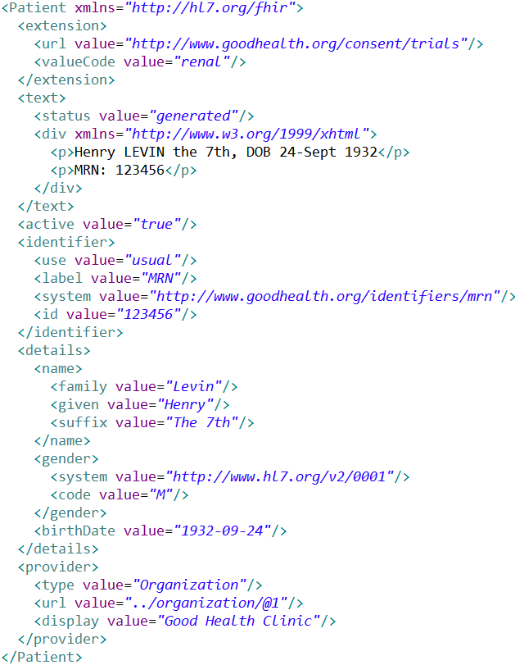
Extension with reference to its definition
Human Readable
Summary
Standard Data Content:
MRN
Name
Gender
Date of Birth
Provider
20

Slide 21
Resources
Resources have 3 parts
Defined Structured Data
The logical, common contents of the resource
Mapped to formal definitions/RIM & other formats
Extensions
Local requirements, but everyone can use
Published and managed
Narrative
Human readable (fall back)

Slide 22
Using Resources
Classic HTTP RESTful approach
Simple approach led by Facebook, Twitter, etc.
Atom (RSS feed standard)
Use Atom to “bundle” resources
Pub/sub framework, Multi-resource Transactions
Messages (v2-like), Documents (per CDA)
Custom Services / SOA
Same content
Same base rules

Slide 23
The Specification
Introduction
Background, basics, framework
Implementation
HTTP, conformance, JSON, etc.
Resource Definitions
Actual logical definitions of resources and their behaviour

Slide 24
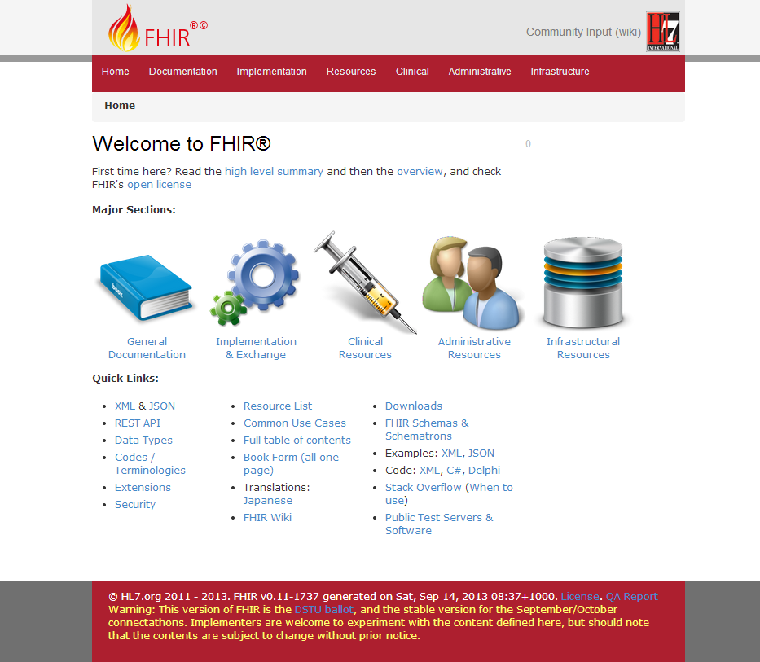

Slide 25
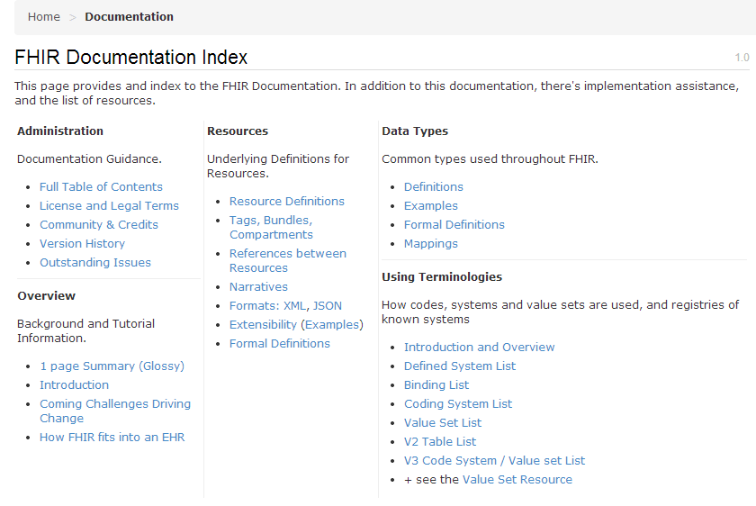

Slide 26
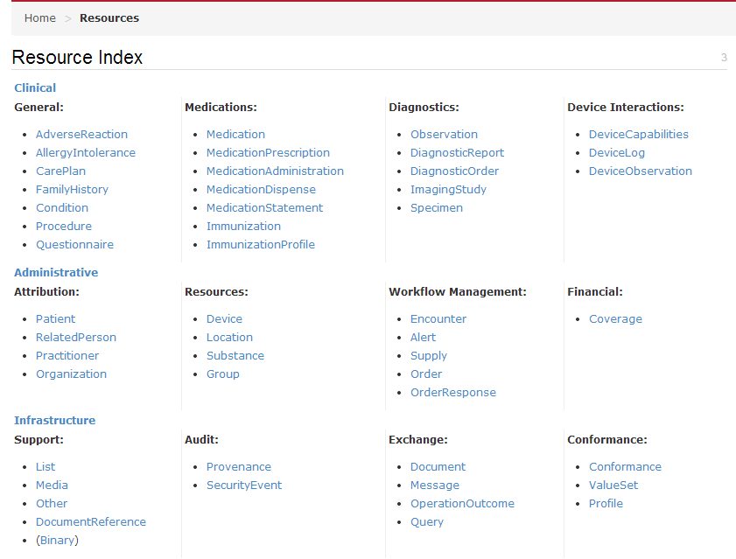

Slide 27
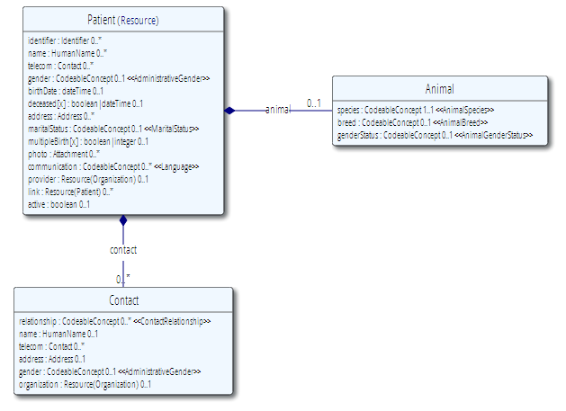
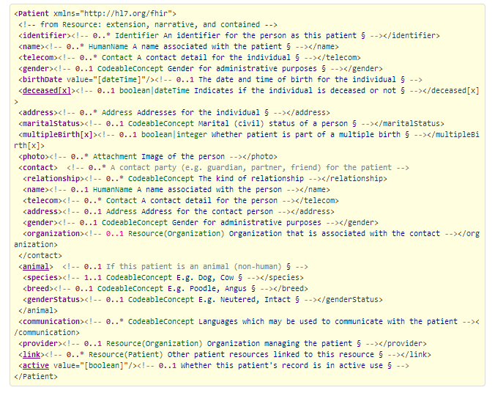

Slide 28
Extensions
Managing extensibility is a central problem
Everyone needs extensions, everyone hates them
FHIR tames extensibility
Built in extensibility framework (engineering level)
Define, publish, find extensions
Use them
This tames the overall specification

Slide 29
Ethos
Simplicity / Web alignment
Implementation focused
Reference Implementations published
Publically available test servers (now)
Connectathon
Freely available
http://hl7.org/fhir
Unencumbered – free for anyone to use

Slide 30
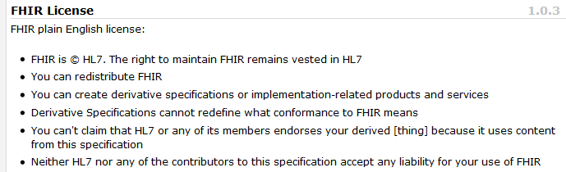
License

Slide 31
Collaborations
IHE
investigating - use of FHIR for MHD (mobile XDS)
DICOM
interested - RESTful access to image metadata
W3C
Semantic health group helping us with RDF
Lots of work to be done

Slide 32
Future Plans
DSTU (reconciliation now)
Infrastructure very solid (implementation focus)
Definitions & Mappings need work
Resource coverage needs to broaden
Future:
Testing, real world implementation experience

Slide 33
FHIR
Simple…. FAST…
Easy to use and understand
Standard skills, tools
Cost-effective information sharing

Slide 34
FHIR Impact
FHIR can be a game changer
Front -> Back, all usages of healthcare, all using the same spec
Remarkable reduction in cost to exchange health records
This will take time to eventuate
Initial impact will be unequal

Slide 35
FHIR Specification
http://hl7.org/fhir
Web based specification
Namespaces (XML & Tx) point directly to the specification
Specification itself is constructed to enable RESTful integration of the spec into run-time systems
This is a work in progress

Slide 36
Paradigms
FHIR supports 4 interoperability paradigms
REST
Documents
Messages
Services

Slide 37
REST
Simple, out-of-the-box interoperability
Leverage HTTP: GET, POST, etc.
Pre-defined operations
Create, Read, Update, Delete
Also: History, Read Version, Search, Updates, Validate, Conformance & Batch
Works best in environments where control resides on client side and trust relationship exists
Rest
Notes:
URLs, parameters, etc. all defined
Choice of what operations to support
Behavior documented in conformance profile - mandatory

Slide 38
Documents
Similar to CDA
Collection of resources bound together
Root is a “Document” resource
Just like CDA header
Sent as an ATOM feed
One context
Can be signed, authenticated, etc.
Documents

Slide 39
Messages
Similar to v2 and v3 messaging
Also a collection of resources as an ATOM feed
Allows request/response behavior with bundles for both request and response
Event-driven
E.g. Send lab order, get back result
Can be asynchronous
Messages

Slide 40
Service Oriented Architecture (SOA)
Do whatever you like
(based on SOA principles)
Ultra complex workflows
Ultra simple workflows
Individual resources or collections (in Atom or other formats)
Use HTTP or use something else
Only constraint is that you’re passing around FHIR resources with basic metadata
Services

Slide 41
Paradigms
Regardless of paradigm the content is the same
This means it’s straight-forward to share content across paradigms
E.g. Receive a lab result in a message. Package it in a discharge summary document
It also means constraints can be shared across paradigms
E.g. Define a profile for Blood Pressure and use it on resources in messages, documents, REST and services

Slide 42
Architectures
FHIR makes no assumptions about the architectural design of systems
You can use it for
Light or heavy clients
Central server or peer-to-peer sharing
Push or pull
Query or publish/subscribe
Loosely coupled or tightly coupled environments
With history tracking or without

Slide 43
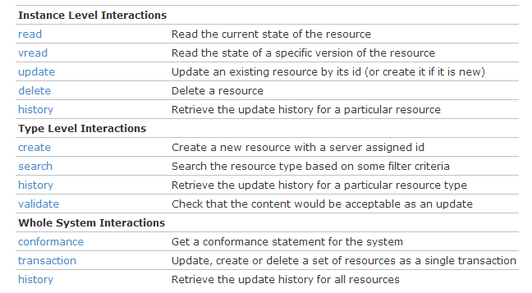
REST in detail

Slide 44
REST
It’s entirely up to the server how the API is implemented
Options:
A dedicated repository of FHIR resources
A virtual view of relational database (classic application)
A data store built from CDA documents
A middleware façade to other server(s)

Slide 45
REST in detail

Slide 46
REST
All operations
Can secure using HTTP security approach of choice (FHIR doesn’t fix)
Can specify XML or JSON as part of operation (server may conform)
Unicode (UTF-8)
Have a common root URL (e.g. http://www.acme.org/fhir/....)
Server chooses what operations to support

Slide 47
Operations
Read–retrieve the current version of the resource: GET [base]/[resourcetype]/{@id}
VRead – retrieve a specific past version of the resource: GET [base]/[resourcetype]/{@id}/history/{@vid}
Servers must support vread of the current version

Slide 48
Operations
Create – create a new resource with server assigned ID POST [base]/[resourcetype]
Server returns ID in the response
Update – update (or create if needed) resource with named ID PUT [base]/[resourcetype]/{@id}
There is a protocol for version-aware updates

Slide 49
Operations
Delete - removes an existing resource: DELETE [base]/[resourcetype]/{@id}
ID can never be used
History can still be retrieved
Not a true delete
May be resurrected
Deleted resources not found in searches

Slide 50
Operations
Transaction - submits a set of resources to be updated, created or deleted on the server: POST [base]
A bundle (atom feed) of resources
Uses: push-based pub/sub, & single transaction on multiple resources
Transactions fails or succeeds as a whole
Many business practices rely on this

Slide 51
Operations
Search: GET [base]/[resourcetype]/(?parameters)
Returns an ATOM feed of results
Parameters specified by server
Basic parameters defined in specification
Atom feed includes paging support
Results can be sorted

Slide 52
Advanced Search
Can specify to search on missing or present values (rather than a particular value)
Can search across resource references (i.e. all lab reports where patient is a female in the age of 30-40)
Can ask the server to include referenced resources in response
Full search is the hardest part of writing a server

Slide 53
Operations
Validate – is attached content acceptable as an update? POST [base]/[resourcetype]/validate/{@id}
may be the first part of a light two- phase commit process
Conformance – get conformance resource that defines server functions: GET [base]/metadata OPTIONS [base]
Specifies resources, operations, parameters, rules

Slide 54
Operations
History – get history of particular resource, all resources of a given type, or all resources supported by the system: GET [base]/[resourcetype]/{@id}/history GET [base]/[resourcetype]/history GET [base]/history
Includes deleted versions of resources
Can be restricted to a particular time (pub/sub)
Can be paged

Slide 55
REST Limitations
How do you handle metadata on transactions?
Typical national programs capture extensive metadata around the transaction (clinical workflow context, not IT platform context)
Out of the box, REST doesn’t solve this well (e.g. trust client to keep suitable audit logs)

Slide 56
REST Advantages
Seamless integration into web (i.e. debug from browser, use web technologies)
Access is not workflow restricted, but not behind the back of the logic
Leverage in many directions
Technical
Social
Personnel / Skills

Slide 57
Operations
The API presents a view of operations on a repository of resources
It can be used in multiple ways:
Source hosts repository – consumer reads it
Consumer hosts repository – source pushes into it
Source provides history – consumer polls it
Source pushes history as batch updates
Can introduce a middleware engine to mix modes

Slide 58
FHIR Resources
Notes:
10:00

Slide 59

Resources
“Resources” are:
Small logically discrete units of exchange
Defined behaviour and meaning
Known identity / location
Smallest unit of transaction
“of interest” to healthcare
V2: Sort of like Segments
V3: Sort of like CMETs

Slide 60
What’s a Resource?
Examples
Non-examples
Administrative
Person, Patient, Organization, Facility, Coverage, Invoice
Clinical Concepts
Allergy, Problem, Family History, Care Plan
Infrastructure
Document, Message, Profile, Conformance
Gender
Too small
Electronic Health Record
Too big
Blood Pressure
Too specific
Intervention
Too broad
100-150 total - ever
Notes:
And few systems will ever see more than 40-50

Slide 61
Resource elements
Resources are defined as an XML structure based on desired wire syntax
Hierarchy of elements
Each element has
Name
Either a datatype or nested elements
Cardinality
All collections are nested in a containing element
Definition
RIM mapping

Slide 62
It’s all about the resources . . .
Facility
Lab
Report
Person
Patient
Agent

Slide 63
Profiles
Document constraints and extensions on one or more resources
May also define new extensions search terms, new messaging events, etc.
Looks an awful lot like the definition of the resources themselves
You can download profile XML for all resources

Slide 64
Resource representations
Each resource is published with several views covering different aspects
UML diagram
Simple pseudo-XML syntax
Vocabulary bindings
Notes
Search Criteria
Data dictionary
Example instance
Schema + Schematron
RDF, XMI, etc. to come

Slide 66
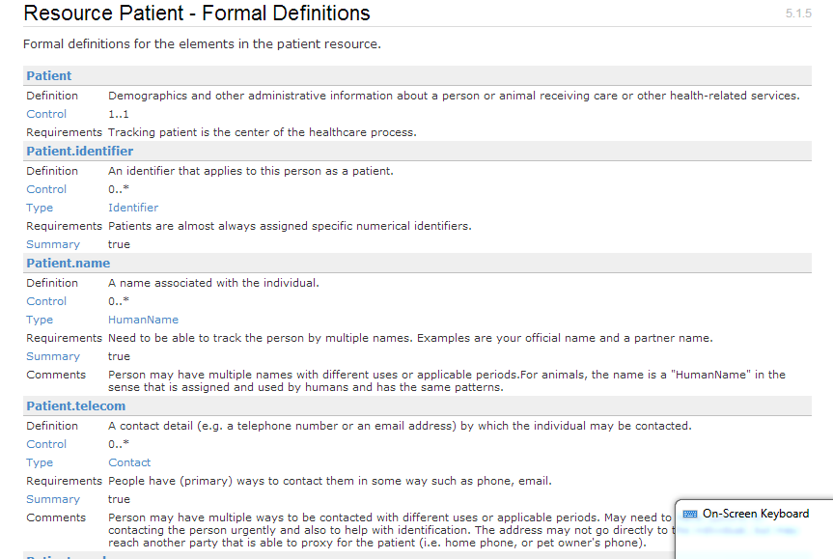
Example - Person

Slide 67
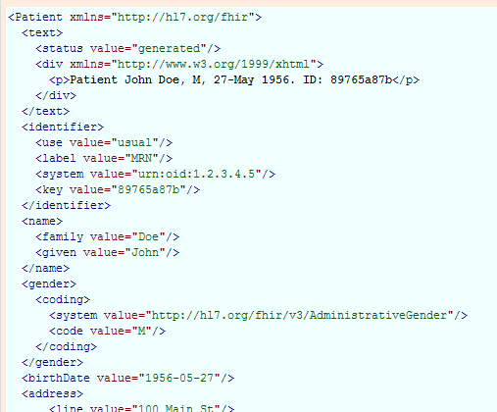
Example - Person

Slide 69
Initial Focus
Cover for basic PHR on social media
Cover CCDA breadth
Other resources as people want them

Slide 70
The Case for Extensions
Extensions are often problematic in existing HL7 specs
Z-segments in v2
What does this mean?
ZSB|20080117|Q^57|4.30^uL
Foreign namespaces in CDA/V3
Break schemas
Simple choice – design for absolutely everything or allow extensions

Slide 71
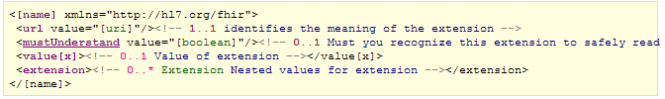
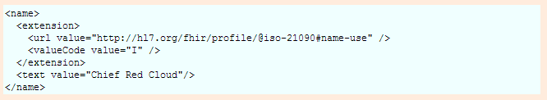
Extension

Slide 72
Definition of an Extension
Field | Use
Context | Where this extension can be used
Definitions | What this extension means (short and long)
Requirements | Why this extension was defined
Comments | Comments about how to use the extension etc
Cardinality | Min..Max
Type | What type(s) this extension is allowed to be
XPaths | Additional constraints on it’s usage
Binding | If a coded element
Must-Understand | If you can ignore this or not
Mappings | Mappings to other specifications i.e. v2, RIM, snomed…

Slide 73
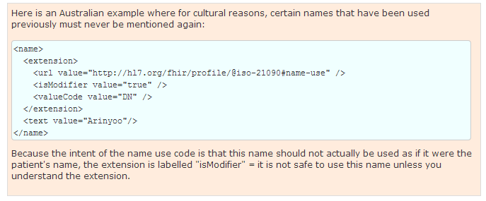
Is-Modifier
When extensions are used to qualify the meaning of other existing elements or even to negate their meanings

Slide 74
Extensions without the pain…
All extensions are handled by infrastructure
Read, write, store, exchange – but not understand
Consult reference to know meaning of data
All systems processing resources MUST check for must-understand extensions
Include important extensions in the narrative

Slide 75
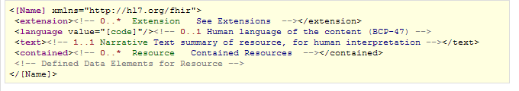
Resources
Metadata Item | Type | Usage
Logical Id | id | The identity of the resource. Known and constant
Version Id | id | Changed each time the content of the resource changes.
Last Modified Date | instant | Used by a system or a human to judge the currency of the resource content.

Slide 76
Resource Bundles
A linear list of resources
Each carries metadata with it
May refer to each other, or externally
Technically: an atom feed (internet pub/sub)
Other Uses:
Searches
Documents & Messages
Batch operations

Slide 77
Conformance
Each Element:
Cardinality (0..1, 1..1, 0..*, 1..)
Is-Modifier – contents affect interpretation of other elements (only used when elements are defined)
Must-Support – application must “support” it (never used in the specification itself)
Invariants – rules expressed in XPath

Slide 78
It’s all about the resources . . .
Facility
Lab
Report
Person
Patient
Agent

Slide 79
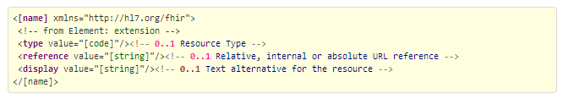
Resource References
Refer from one resource to another
URLs (relative or absolute)
References are uni-directional technically, but semantically bi-directional

Slide 80
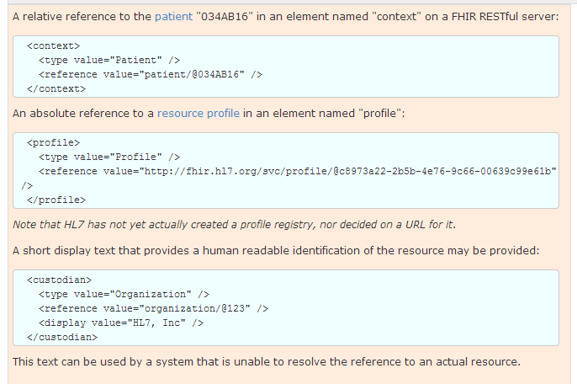
Resource References

Slide 81
Contained Resources
In REST, each resource has a known unambiguous identity
Key enabler of outcomes for REST
But quite often, in healthcare, you can’t do that
No unambiguous info (i.e just a user name)
Identifiers may be re-assigned or unscoped

Slide 82
Case Example
Generate FHIR resources from this message: MSH|^~\&|||||20100727114703||ORM^O01^ORM_O01|288095|T|2.4 PID|1||||LAST^FIRST^M||19011215|F|||||||||| ORC|XE|12312|||||||||1000 OBR|1|1231||GLU|||20061114102100||||||||SER||||^^^^^^P OBR|2|1231||UREA|||20061114102100|20061114103100|||||||SER||||^^^^^^P
An observation request that refers to a subject, but what’s the subject?

Slide 83
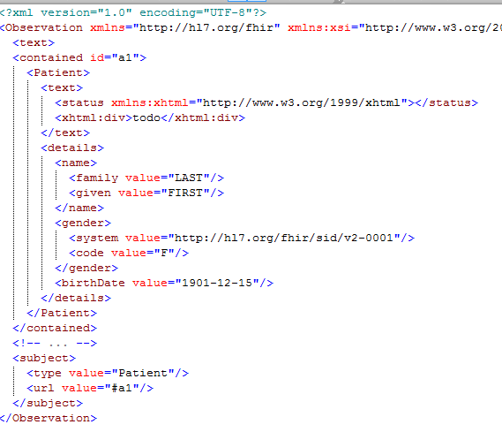
Case Example

Slide 84
Case Example
Revised – add an account number: MSH|^~\&|||||20100727114703||ORM^O01^ORM_O01|288095|T|2.4 PID|1||||LAST^FIRST^M||19011215|F||||||||||998877 ORC|XE|12312|||||||||1000 OBR|1|1231||GLU|||20061114102100||||||||SER||||^^^^^^P OBR|2|1231||UREA|||20061114102100|20061114103100|||||||SER||||^^^^^^P
Is the account number useable as a primary key?

Slide 85
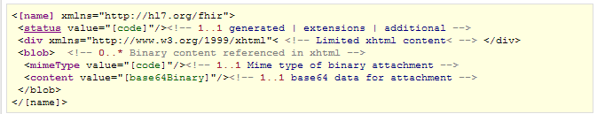
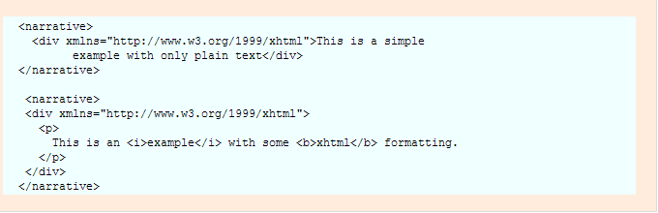
Formats - XHTML

Slide 86
XHTML Restrictions
Allowed:
basic formatting described in chapters 7-11 (except section 4 of chapter 9) and 15 of the HTML 4.0 standard,
<a> elements (either name or href),
images and internally contained style attributes.
Not allowed:
head, body, external stylesheet references
scripts, forms, base/link/xlink, frames, iframes, and objects.
Rule:
The div element must have some non-whitespace content

Slide 87
Formats - JSON
Enterprises, national programs still very focused on XML
Conformance tooling, still learning how to implement it
Many implementers have moved on to JSON
Simpler to parse, work with
Integrates really well with web
FHIR JSON format is algorithmic transform from XML

Slide 88
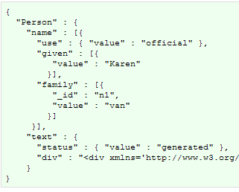
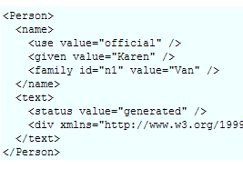
Formats - JSON

Slide 89
JSON Differences
No namespaces
Order is not significant
XML Attributes (xml:id, value) are treated as JSON object members
JSON arrays (even if elements do not repeat in the actual instance)
XHTML <div> element is represented as a single escaped string of XHTML.

Slide 90
FHIR Manifesto
Focus on Implementers
Target support for common scenarios
Leverage cross-industry web technologies
Require human readability as base level of interoperability
Make content freely available
Support multiple paradigms & architectures
Demonstrate best practice governance

Slide 91
Where can FHIR be used?
Classic in-institution interoperability
Back-end e-business systems (e.g. financial)
Regional Health Information Organizations (RHIO)
National EHR systems
Social Web (Health)
Mobile Applications
Near
Term

Slide 92

Migration
Realistically, we don’t expect anyone to migrate existing interfaces any time soon.
Initial adopters will be green-field, new technology
FHIR may see use behind the scenes in v2 systems before it sees use over the wire

Slide 93
Migration – v2
Already have an integration engine that supports translation between v2 and FHIR
Resources map to segments reasonably well
As always, the challenge with v2 mapping is the variability of v2 interfaces
“Common” mappings can be created, but they won’t be one size fits all
HL7 v2

Slide 94
Migration – v3
V3 migrations should be more straight-forward as semantics are clear
Migrations will tend to be based on templates and realm constraints rather than international specs
Round-trip transforms are possible
Which get targeted first will depend on implementer desires
HL7 v3

Slide 95

Migration – CDA
Made more complex by human-readable nature
Need to ensure text <-> entry linkages are retained
Will best be handled on a template by template basis
Likely start with important ones like C-CDA
Notes:
12:15
Text linkages not as important when not human-attested

Slide 96
Reference Implementations
Java (used in build)
C#
Delphi (I use)
javascript?
eCore?
iOS
Lua?
Anything else people ask for

Slide 97
Implementations
Publically available servers: http://wiki.hl7.org/index.php?title=Publicly_Available_FHIR_Servers_for_testing
At least two servers planned as commercial offering
Projects doing pre-production mockups
Some plan to go live this year!
Vendors doing pre-production development of social PHRs

Slide 98
FHIR Implementation
XDS repository (DocumentReference)
National & Regional Health Record Repositories
DICOM VNA access
V2 Messaging (Clinical content first)
Projects already happening

